Slide 1
Excalibur
Team Members -
Shivaraman Ramakrishnan (RA1911042010008)
Rryan Jebaseelan (RA1911042010040)
Pavan Nikhil Yetaru (RA1911042010044)

Slide 2
Arduino based multi water tester
Agriculture is the backbone of our country and it is very important to know the parameter of soil and water for efficient harvesting. The various parameters that can be monitored are Soil moisture, pH of water, Temperature, etc.
Our initial idea as of now is to develop a sort of tester using Arduino where the tester gives us the parameters of the water which is being tested and we will not only be combining them but also display them on a webpage so that they can be monitored from anywhere in the world.

Slide 3
Objective
Build the physical model
Program the arduino board and the NodeMCU
Prepare a webpage to display the results of the tester.

Slide 4
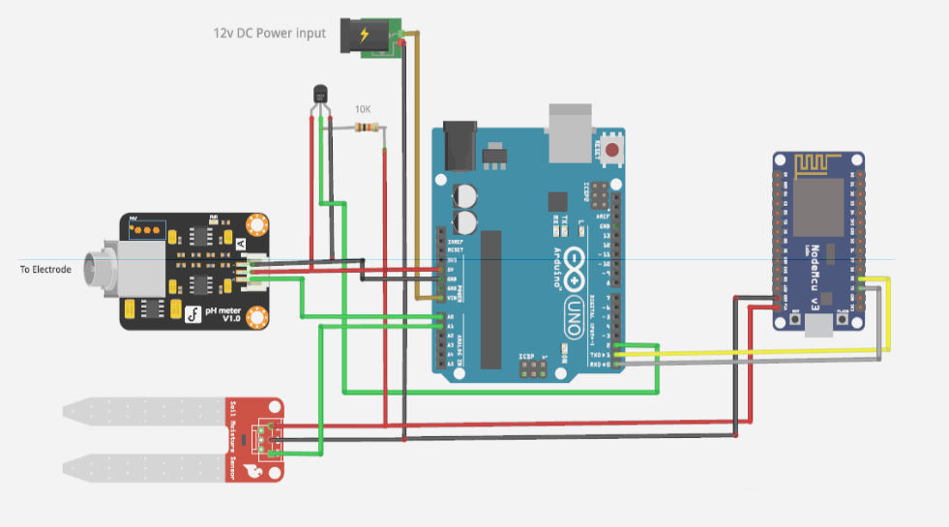
Block diagram of the model

Slide 5
Plan and action
We have purchased all but one item of the physical model as of now. The written part of the code is going on but to test its proper functionality we have to build the circuit. The item is being a bit hard to procure due to current circumstances but we are sure that we will be able to assemble it soon.
There are two parts of in this project, one is where the arduino is programmed and the second is for the NodeMCU. That’s the items we are struggling to get our hands on for this project.

Slide 6
Gantt Chart

Slide 7
Workshops to attend
As of now we haven’t attended anything, but we will update it once we participate in one.

Slide 8
Conclusion
Water is a critical input for agricultural production and plays an important role in food security. water is essential for the germination of seeds, growth of plant roots, and nutrition and multiplication of soil organism. Water is essential in hydraulic process in the plant. Our hope is that this project idea of ours turns out to be fruitful and help us get the correct data that is in the water sample which will inturn help us improve the cultivation.
And this project will also help us work together as a team and understand our team members strengths and weaknesses and develop ourselves.

Slide 9
References
https://www.google.com/url?sa=t&rct=j&q=&esrc=s&source=web&cd=&cad=rja&uact=8&ved=2ahUKEwiqj6uhrsryAhU1iOYKHREUCSkQFnoECAYQAw&url=https%3A%2F%2Fwww.arduino.cc%2F&usg=AOvVaw0_8388xK8DUMwMCI1wAZ_C
https://www.google.com/url?sa=t&rct=j&q=&esrc=s&source=web&cd=&cad=rja&uact=8&ved=2ahUKEwigga6ursryAhUr7XMBHV3ADCAQFnoECCEQAQ&url=https%3A%2F%2Fgithub.com%2Fnodemcu%2Fnodemcu-firmware&usg=AOvVaw0arIWNMQonMu47kI9aqLJz
https://www.google.com/url?sa=t&rct=j&q=&esrc=s&source=web&cd=&cad=rja&uact=8&ved=2ahUKEwiNq8TSrsryAhVE7XMBHU01CZQQFnoECAQQAQ&url=https%3A%2F%2Fcreate.arduino.cc%2Fprojecthub%2Fchanhj%2Fwater-quality-monitoring-system-ddcb43&usg=AOvVaw1oIEsKjiwDm_zqasvKBZyi
https://www.google.com/url?sa=t&rct=j&q=&esrc=s&source=web&cd=&cad=rja&uact=8&ved=2ahUKEwiNq8TSrsryAhVE7XMBHU01CZQQFnoECA4QAQ&url=https%3A%2F%2Fwww.pantechsolutions.net%2Fiot-based-water-quality-management-system-using-arduino&usg=AOvVaw1PeDJUS_2h2hIwzHkgvKhs

